Slide 1
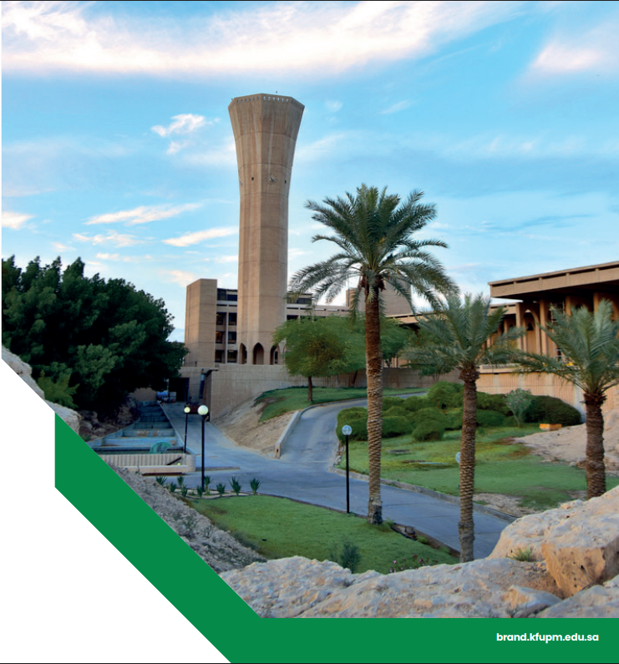

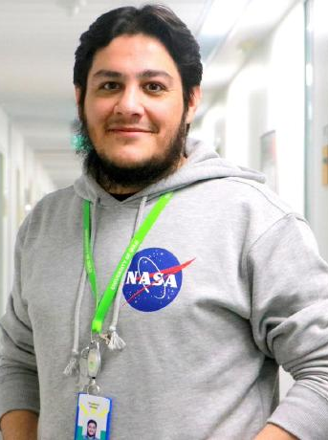

Moonlight: Enhanced Deep Learning for Breast Cancer Detection
An advanced framework designed to improve accuracy, robustness, and interpretability of breast cancer diagnosis from histopathological images.
Dr. Muzammil Behzad
Assistant Professor
Information & Computer Science Department,
King Fahd University of Petroleum and Minerals, Saudi Arabia.
Eng. Hassan Al-Dahneen
MX Student – Artificial Intelligence
Information & Computer Science Department,
King Fahd University of Petroleum and Minerals, Saudi Arabia.

Slide 2

AGENDA
1
Intro - Breast Cancer
1 Min
2
Current DL Models For Breast Cancer & Their Limitations
1 Min
3
Proposed Enhancements
4 Min
4
Results & Observations
2 Min
5
Future Work
1 Min
6
What I Learned
1 Min

Slide 3

Intro - Breast Cancer
Breast cancer remains one of the most prevalent and life-threatening diseases among women worldwide. Early and accurate diagnosis is critical for improving survival rates and treatment outcomes.
1
Histopathological Analysis
The gold standard for diagnosing breast cancer, but often time-consuming and dependent on expert pathologists.
2
Manual Examination
Can introduce variability and errors due to fatigue or subjective interpretation.

Slide 4
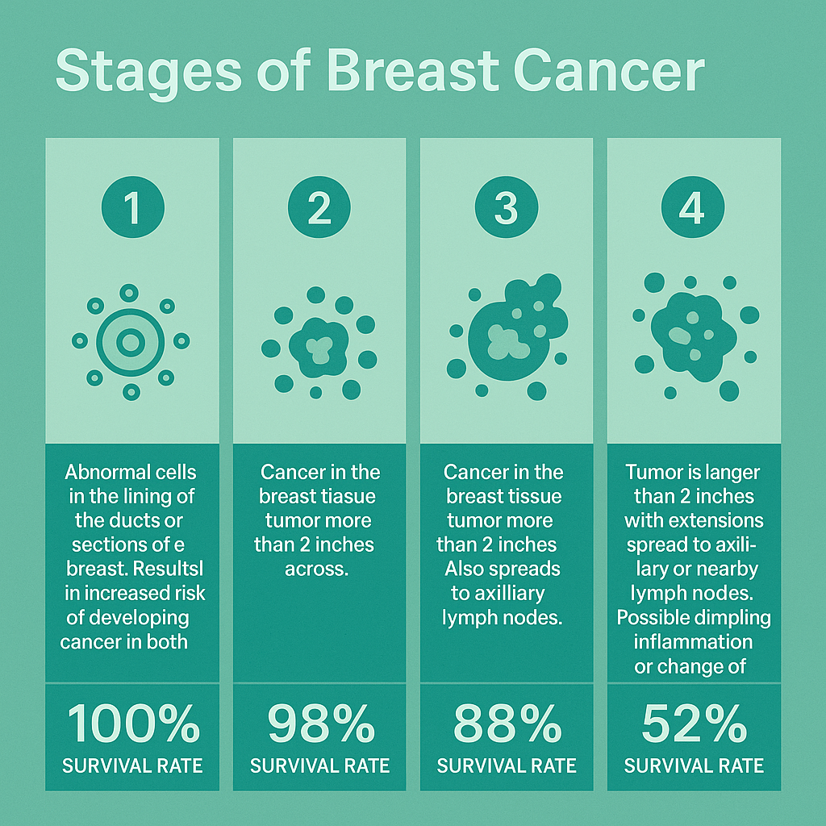




Intro - Breast Cancer “Continue”
Breast Pain
Nipple Discharge
Redness Or Swelling In One Breast
Change In The Apparency Of The Nipple

Slide 5
Current DL Models For Breast Cancer & Their Limitations
Domain Misalignment
Insufficient Loss Optimization
Insufficient Data Augmentation
Lack of Interpretability
Color Information Loss
Notes:
Domain Misalignment: Pretrained DL model is not optimized for histopathological features of different Cancer types.
Insufficient Loss Optimization: Conventional loss functions like cross-entropy do not always reflect the structural or perceptual similarity required in fine-grained medical image classification, leading to suboptimal feature learning and misclassification of borderline cases.
Insufficient Data Augmentation: Basic augmentations don't simulate real-world slide variability.
Lack of Interpretability: Black-box predictions limit clinical adoption.
Color Information Loss: Grayscale inputs discard vital diagnostic color cues.

Slide 6
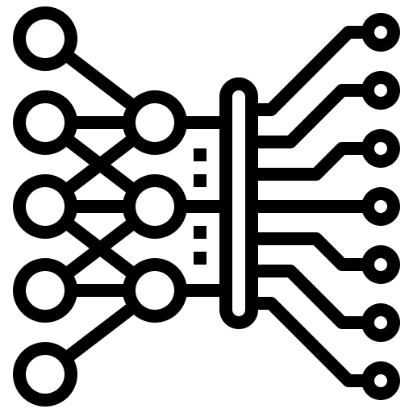
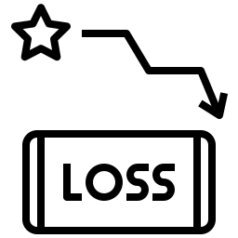

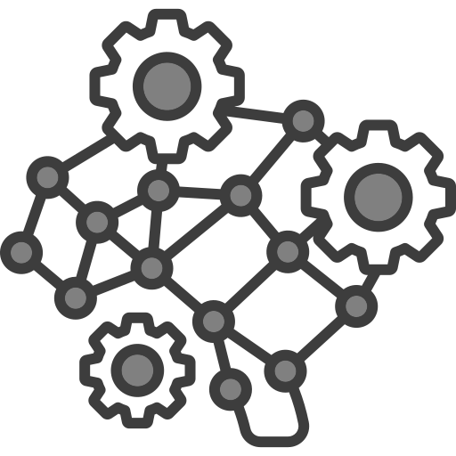
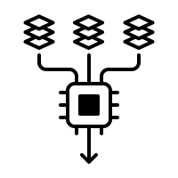


Proposed Enhancements
Model
Loss
Augmentation
Training
Testing
Interpretability
Config
Added residual, efficient, and U-Net classifiers with plug-and-play architecture loader
Introduced Focal, and Composite loss with modular config
Advanced augmentation option to simulate clinical variability
Configurable via CLI, supports AMP, early stopping, learning rate scheduling
Extended to compute and display full performance metrics
Grad-CAM++ and Grad-CAM implemented for XAI support
Reproducible experiment design using structured JSON + CLI control

Slide 7
Proposed Enhancements – New Models Architecture
SimpleCNN
15 Layers: 3×Conv + 3×ReLU + 3×MaxPool + AdaptiveAvgPool + Flatten + 2×FC + 2 In/Out
ResidualModel
18 Layers: 3×Conv + 3×BN + 2×ReLU + MaxPool + 2×ResidualBlock(Conv+BN+ReLU) + AdaptiveAvgPool + Flatten + FC + 2 In/Out
EfficientConvModel
16 Layers: 3×Depthwise + 3×Pointwise + 3×BN + 3×ReLU + AdaptiveAvgPool + Flatten + FC + 2 In/Out
UNetClassifier
21 Layers: 4×Conv + 4×BN + 4×ReLU + 4×MaxPool + ResidualBlock(2×Conv+2×BN+ReLU) + AdaptiveAvgPool + Flatten + 2×FC + 2 In/Out
Input Layer (Image size: 224 × 224 × 3)
Input Layer (Image size: 224 × 224 × 3)
Input Layer (Image size: 224 × 224 × 3)
Input Layer (Image size: 224 × 224 × 3)
Convolution Layer 1 → ReLU → MaxPooling
(Conv2d: in_channels=3, out_channels=32, kernel_size=3)
Conv2D (3→32) → BatchNorm → ReLU → MaxPool (2×2)
Encoder Block 1
Conv2D (3→32) → BatchNorm → ReLU → MaxPool (2×2)
Depthwise Separable Conv Block 1
├ Depthwise Conv (3→3) → Pointwise Conv (3→32)
└─ BatchNorm → ReLU
Encoder Block 2
Conv2D (32→64) → BatchNorm → ReLU → MaxPool (2×2)
Convolution Layer 2 → ReLU → MaxPooling
(Conv2d: in_channels=32, out_channels=64, kernel_size=3)
Residual Block 1
├ Conv2D (32→64) → BatchNorm → ReLU
├ Conv2D (64→64) → BatchNorm
└─ Shortcut (identity)
→ Element-wise Add → ReLU
Depthwise Separable Conv Block 2
├ Depthwise Conv (32→32) → Pointwise Conv (32→64)
└─ BatchNorm → ReLU
Encoder Block 3
Conv2D (64→128) → BatchNorm → ReLU → MaxPool (2×2)
Convolution Layer 3 → ReLU → MaxPooling
(Conv2d: in_channels=64, out_channels=128, kernel_size=3)
Encoder Block 4
Conv2D (128→256) → BatchNorm → ReLU → MaxPool (2×2)
Residual Block 2
├ Conv2D (64→128, stride=2) → BatchNorm → ReLU
├ Conv2D (128→128) → BatchNorm
└─ Shortcut: Conv2D (64→128, stride=2) → BatchNorm
→ Element-wise Add → ReLU
Depthwise Separable Conv Block 3
├ Depthwise Conv (64→64) → Pointwise Conv (64→128)
└─ BatchNorm → ReLU
Residual Block (within bottleneck)
├ Conv2D (256→256) → BatchNorm → ReLU
└─ Conv2D (256→256) → BatchNorm
→ Element-wise Add (Residual Connection) → ReLU
Adaptive Average Pooling (1×1)
Flatten
Adaptive Average Pooling (1×1)
Adaptive Average Pooling (1×1)
Adaptive Average Pooling (1×1)
Fully Connected Layer 1
(Linear: in_features=128, out_features=128) → ReLU → Dropout(0.5)
Flatten
Flatten
Flatten
Fully Connected Layer 1
(Linear: 256 → 128) → ReLU → Dropout(0.5)
Fully Connected Layer 2
(Linear: in_features=128, out_features=2)
Fully Connected (Linear: 128 → 2)
Fully Connected (Linear: 128 → 2)
Fully Connected (Linear: 128 → 2)
Output Layer (Softmax for 2 classes: Benign / Malignant)
Output Layer (Softmax for 2 classes: Benign / Malignant)
Output Layer (Softmax for 2 classes: Benign / Malignant)
Output Layer (Softmax for 2 classes: Benign / Malignant)
Note that DenseNet121 uses the torchvision.models.densenet121 and it has ~121+2 layers “As per paper: 121 layers (conv/bn/relu) + final Linear classifier”.

Slide 8
Proposed Enhancements – Loss
1
3
CrossEntropy
Standard loss that penalizes incorrect class prediction by comparing logits to true label.
PerceptualLoss
Measures similarity between predicted softmax distribution and true labels using MSE.
2
4
FocalLoss
A dynamically scaled version of CrossEntropy Loss that focuses learning on harder examples.
CompositeLoss
A hybrid combining CrossEntropy Loss and Perceptual Loss to balance classification and distribution alignment.
CrossEntropy is the standard PyTorch (nn.CrossEntropyLoss). While other 3 loss functions were manually implemented.

Slide 9
Proposed Enhancements - Augmentation
1
Basic Augmentation:
Resize(224×224)
Normalize(mean=0.5, std=0.5)*
Applied to all training images with no variability
2
1
2
Advanced Augmentation
Normalize(mean=0.5, std=0.5)*
RandomResizedCrop(224)
RandomHorizontalFlip(p=0.5)
RandomRotation(degrees=15)
ColorJitter: modifies brightness and contrast
* Normalization was changed after experiment 9 to be Normalize((0.5, 0.5, 0.5), (0.5, 0.5, 0.5)) so both will process full RGB image instead of grayscale only.

Slide 10
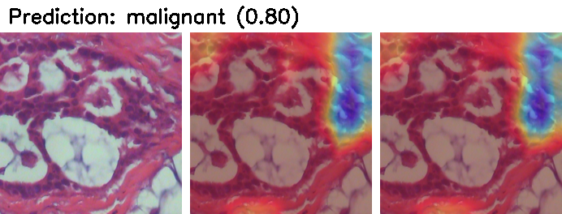
Proposed Enhancements – Training, Testing and Interpretability
Save Best
Input
Augment
Processing & Training
Validate & Monitor
Testing and Evaluation
Visual Explanation
DL Model
Notes:
Preprocessing: Include resizing, flipping, rotating, and color adjustments. These augmentations help the model generalize better by simulating real-world variations.
Once the images are processed, they are fed into a deep learning model. The model is trained to distinguish between benign and malignant tissue patterns.
During training, the system monitors how well the model performs on validation samples and automatically saves the best version of the model for later testing.
After training, the saved model is tested on previously unseen images. The system generates a full performance report that includes accuracy, precision, recall, and F1-score.
To make the model’s decisions understandable, a visual explanation technique called Grad-CAM is used. It highlights the areas in the tissue image that the model focused on when making its prediction. This helps build trust and offers insights for clinical review.

Slide 11
Results & Observations
Experiments Setup
Exp # | Architecture | Loss Function | Augmentation | Input Type
Exp1 | DenseNet121 | CrossEntropy | Basic | Grayscale
Exp2 | ResidualModel | CrossEntropy | Advanced | Grayscale
Exp3 | EfficientConvModel | CrossEntropy | Basic | Grayscale
Exp4 | SimpleCNN | CrossEntropy | Basic | Grayscale
Exp5 | ResidualModel | Perceptual | Advanced | Grayscale
Exp6 | EfficientConvModel | CrossEntropy | Advanced | Grayscale
Exp7 | ResidualModel | Composite | Advanced | Grayscale
Exp8 | EfficientConvModel | Composite | Advanced | Grayscale
Exp9 | SimpleCNN | Composite | Basic | Grayscale
Exp10 | UNetClassifier | Composite | Basic | RGB
Exp11 | DenseNet121 | Focal | Basic | RGB
Exp12 | EfficientConvModel | CrossEntropy | Advanced | RGB
Exp13 | ResidualModel | Composite | Advanced | RGB
Exp14 | EfficientConvModel | Composite | Basic | RGB
Exp15 | UNetClassifier | Composite | Advanced | RGB
Exp # | Architecture | Loss Function | Augmentation | Input Type | Accuracy (%) | Precision (%) | Recall (%) | F1 Score (%)
Exp1 | DenseNet121 | CrossEntropy | Basic | Grayscale | 92.08 | 92.02 | 92.08 | 91.98
Exp2 | ResidualModel | CrossEntropy | Advanced | Grayscale | 88.95 | 88.82 | 88.95 | 88.85
Exp3 | EfficientConvModel | CrossEntropy | Basic | Grayscale | 91.75 | 91.69 | 91.75 | 91.65
Exp4 | SimpleCNN | CrossEntropy | Basic | Grayscale | 91 | 91.09 | 91 | 91.03
Exp5 | ResidualModel | Perceptual | Advanced | Grayscale | 87.46 | 87.29 | 87.46 | 87.19
Exp6 | EfficientConvModel | CrossEntropy | Advanced | Grayscale | 85.81 | 86.26 | 85.81 | 84.99
Exp7 | ResidualModel | Composite | Advanced | Grayscale | 88.87 | 88.77 | 88.87 | 88.81
Exp8 | EfficientConvModel | Composite | Advanced | Grayscale | 86.6 | 86.51 | 86.6 | 86.16
Exp9 | SimpleCNN | Composite | Basic | Grayscale | 92.58 | 92.71 | 92.58 | 92.41
Exp10 | UNetClassifier | Composite | Basic | RGB | 94.49 | 94.68 | 94.49 | 94.54
Exp11 | DenseNet121 | Focal | Basic | RGB | 93.12 | 93.24 | 93.12 | 93.16
Exp12 | EfficientConvModel | CrossEntropy | Advanced | RGB | 86.61 | 86.54 | 86.61 | 86.16
Exp13 | ResidualModel | Composite | Advanced | RGB | 86.81 | 86.94 | 86.81 | 86.87
Exp14 | EfficientConvModel | Composite | Basic | RGB | 91.61 | 91.56 | 91.61 | 91.5
Exp15 | UNetClassifier | Composite | Advanced | RGB | 89.48 | 89.51 | 89.48 | 89.49
Original Model
Top Performance Models

Slide 12

Results & Observations
Key Observations
94.49%
Experiment 10 (UNetClassifier with CrossEntropy loss and basic augmentation) achieved the highest overall accuracy (94.49%) and F1 score (0.9454), confirming the benefit of using spatial feature extraction with color information.
Experiment 11 (DenseNet121 with Focal Loss and basic augmentation) achieved strong results (F1 score 0.9316),reinforcing the advantage of handling class imbalance through specialized loss functions. Experiment 14 (EfficientConvModel with Composite loss and basic augmentation) also performed very well (F1score 0.9150), indicating that composite loss strategies combined with color features offer meaningful boosts even for lightweight architectures. Composite loss strategies applied in Experiments 13 to15 consistently resulted in balanced performance across precision, recall, and F1-score, confirming their robust-ness.
Color input (RGB)
U-Net and Residual Architecture
Composite Loss
Significantly improved model performance across all architectures by preserving important color and textural features critical for histopathological diagnosis.
Showed the most benefit when paired with RGB input and enhanced loss functions. Combined with Composite Loss in Experiment 10 it achieved the best overall results.
contributed to consistent and significant gains in both recall and precision across multiple experiments (including Experiments 9, 10, 13, 14, and 15).

Slide 13

Future Work
Future Work
Clinical Validation and Expert Review
Model Optimization
Real-Time Clinical Integration
Generalization to Other Domains
Notes:
Clinical Validation and Expert Review: Future research will focus on validating the model’s predictions with pathologists in real-world clinical settings. The use of Grad-CAM++ will aid in this process by providing visual justification for each classification decision, thereby helping to build trust in AI-supported diagnostics.
Model Optimization: Training time was not recorded in the current experiment logs. However, the framework is designed to allow integration of time tracking in future iterations via log timestamps or explicit time logging.
Real-Time Clinical Integration: The system may be further developed into a real-time diagnostic tool for hospitals and pathology labs, offering decision support or pre-screening capabilities.
Generalization to Other Domains: The modular nature of the framework makes it adaptable to other types of cancer, extending its impact beyond breast cancer diagnosis.

Slide 14





What I Learned
Breast Cancer Knowledge
Building Deep Learning Architecture from Scratch
Experimentation and Log Tracking
Gained a strong understanding of breast cancer pathology, particularly how histopathological features (like nuclear irregularities) can be identified and leveraged by deep learning models for diagnosis.
Learned how to design, implement, and optimize deep learning models manually, understanding each building block such as convolutions, residual connections, and efficient convolutional layers.
Mastered how to systematically conduct experiments by varying model components, track training and evaluation results with structured logging, and ensure reproducibility.
Explainable AI (XAI)
Writing a Research Paper & Crafting a Professional GitHub Report
Learned how to apply visualization techniques like Grad-CAM and Grad-CAM++ to highlight regions of histopathological images that influenced the model’s predictions, making AI decisions interpretable.
Developed skills in structuring a scientific research paper and learned how to prepare a professional GitHub repository with clean documentation and experiments logs.

Slide 15
Project Resources
BreaKHis Dataset
Project Report
Reference Paper
GitHub Repository
Trained Models

